Slide 1
Software Development with UML and Java 2
Threads intro

Slide 2
Agenda
www.menti.com
Threads intro
What are they?
How to start
Sleep
Interrupt
Join

Slide 3
Go to
www.menti.com
Type in numeric code
Write questions

Slide 4
Threads

Slide 5
Processes
A process is just a program.
When you start any program, you start a process.
Eclipse, word, powerpoint, chrome, spotify → all processes.

Slide 6
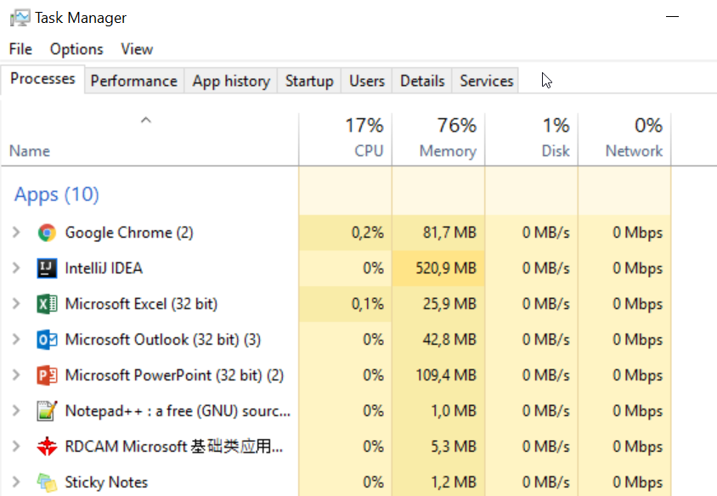

Slide 7
A process can have sub-processes
Sort of like mini programs, running inside the main process
We call these threads. They exist within a process.
I.e. the program can do more than one thing at a time.
Spotify will play the song, while auto-updating lyrics/images, and letting you search for other music
They allow us to perform parallel actions

Slide 8
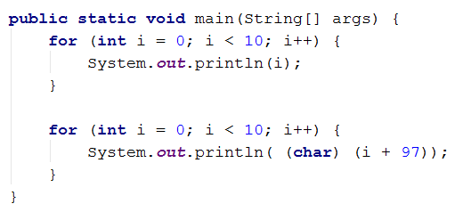
Single threaded program
So far, all your programs have been single threaded.
The code you write is executed in a very specific order.

Slide 9
What if I wanted loops to execute in parallel?
The idea

Slide 10
Single threaded
Main process
Prints numbers
Prints letters

Slide 11
Single threaded
Main process
Prints numbers
Prints letters
0, 1, 2, 3, 4, 5, 6, 7, 8,9, A, B, C, D, E, F, G, H, I, J

Slide 12
Multithreaded
Main process

Slide 13
Multithreaded
Main process
Thread
Prints numbers

Slide 14
Multithreaded
Main process
Thread
Prints numbers
Thread
Prints letters

Slide 15
Multithreaded
Main process
Thread
Prints numbers
Thread
Prints letters

Slide 16
Multithreaded
Main process
Thread
Prints numbers
Thread
Prints letters
0, 1, A, 2, B, C, D, 3, 4, E, 5, 6, F, G, H, 7, I, 8, 9, J, 0

Slide 17
Show print example

Slide 18


Slide 19
How?
2 ways
Define a class, which implements Runnable interface
Lambda expression (sort of outside scope)

Slide 20
Runnable
Existing interface in Java
Contains just the method run()

Slide 21
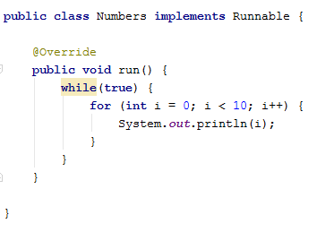
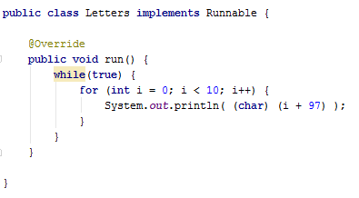
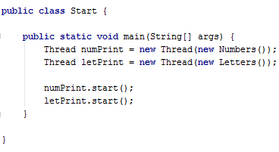
Interface Runnable

Slide 22
The Thread class takes a Runnable class.
When start method is called, a new thread is created, and the run method in the Runnable is called.

Slide 23
NEVER CALL run() DIRECTLY
This will not create a thread, but will just behave as your usual serial code.
Always use the Thread class, and call start.
SUPER IMPORTANT

Slide 24


Slide 25
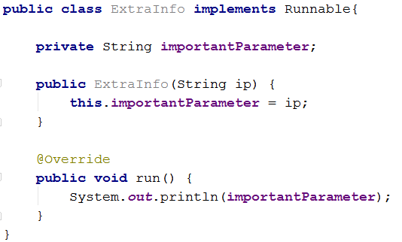
In your “Runnable” class
You can have field variables used by the thread
You can have other methods used by the thread
Creating a Runnable class can provide more functionality.

Slide 26
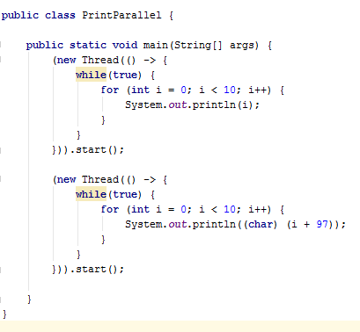
Simplified with lambda

Slide 27
Simplified with lambda

Slide 28


Slide 29
Do you use the start() method or the run() method?

Slide 30
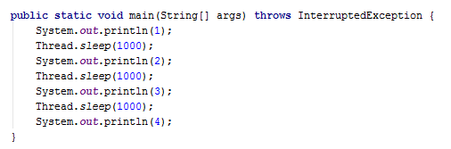
Pausing a thread
We want to print a number every second
Use Thread.sleep(1000);
Argument is in milliseconds.
Examples

Slide 31
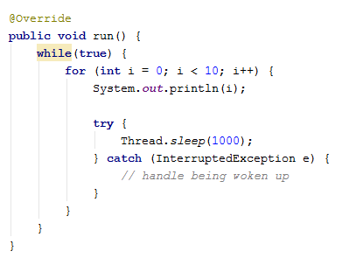

Slide 32
Thread.sleep
Used to put the thread to sleep for x miliseconds

Slide 33


Slide 34

Wake sleeping threads

Slide 35
Wake sleeping threads

Slide 36



Wake sleeping threads
ZZZZZzzz

Slide 37
Wake sleeping threads

Slide 38
Wake sleeping threads

Slide 39

Wake sleeping threads

Slide 40
Convert to program
Need a Bear class
Need a Man class
The bear must sleep
The man must wake the bear after a while
Live program example

Slide 41


Slide 42
Make one thread wait for another to finish
Sometimes threads have to work together
Sometimes they require to work with some data without interference
We can make Thread A wait until Thread B is finished, before it continues.

Slide 43
Join
Example

Slide 44
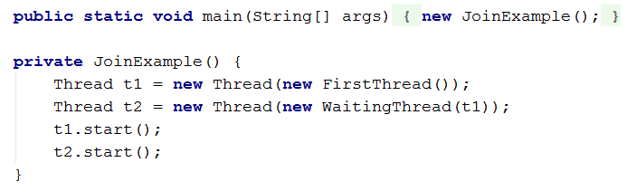
Notice parameter

Slide 45
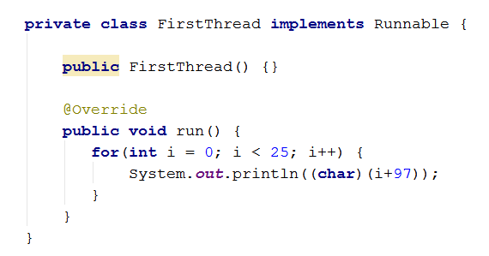

Slide 46
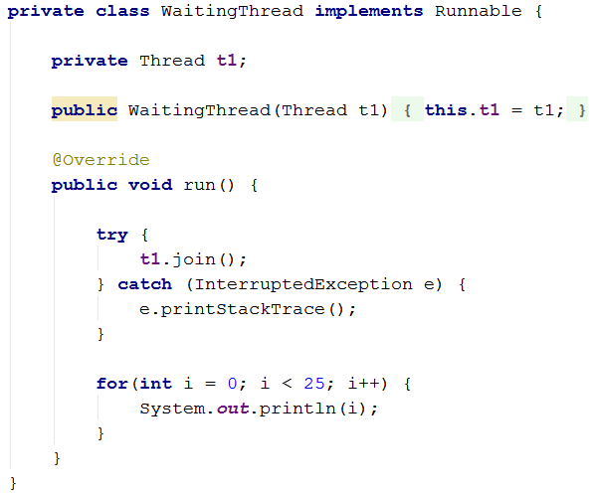
Join

Slide 47
Thread1
Thread2
JOIN

Slide 48
Thread1
Thread2

Slide 49


Slide 50


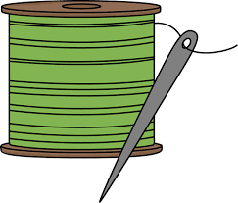

Time slicing
You can run multiple Threads on a single processor.
Only one thread get CPU time at a time, but the threads are swapped often.

Slide 51
Time slicing
You can run multiple Threads on a single processor.
Only one thread get CPU time at a time, but the threads are swapped often.

Slide 52
Time slicing
You can run multiple Threads on a single processor.
Only one thread get CPU time at a time, but the threads are swapped often.

Slide 53
Time slicing
You can run multiple Threads on a single processor.
Only one thread get CPU time at a time, but the threads are swapped often.

Slide 54
Time slicing
You can run multiple Threads on a single processor.
Only one thread get CPU time at a time, but the threads are swapped often.

Slide 55
Time slicing
Modern computers have multiple cores, which means threads can actually be executed at the same time.
The operating system usually takes care of this for us.

Slide 56
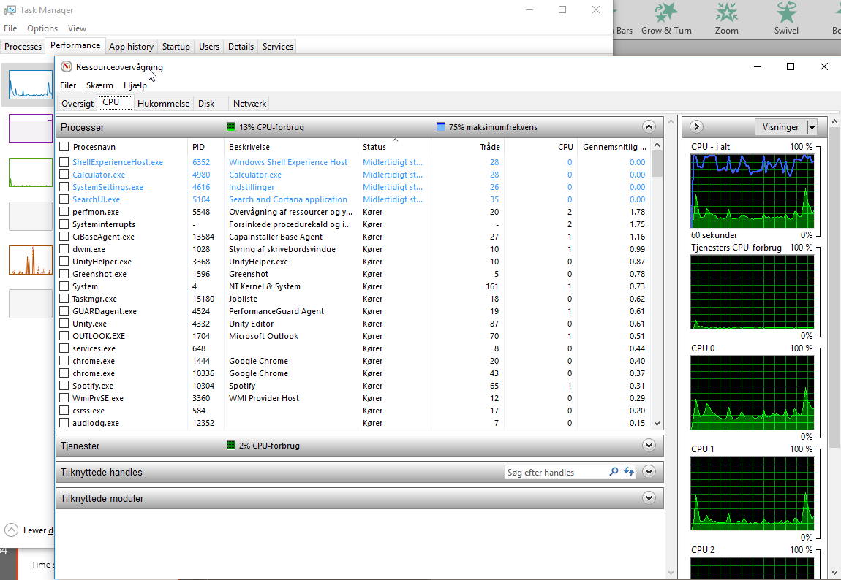

Slide 57


Slide 58
What have we learned today?
Programs are processes, some programs contains sub-processes, called threads, which may run and execute code in parallel.
How to create and execute threads
We can pause a thread with the Thread.sleep() call, and that sleeping threads can be woken up again
We can make one thread wait until another is done executing and has terminated, using Thread.join(otherThread);
Time slicing is when multiple threads run on a single processor, and one thread at a time is given computation time.

Slide 59


Slide 60

S

